Slide 1
Measurement and Metrics in Design

Slide 2
Objectives
To define software metrics and measurement
To understand types of metrics
To understand measurement principles and process
To describe some design metrics

Slide 3
Metrics, Measures and Measurement
A software metric is an important attribute of software product, process, or resource.
A measure is a quantitative or qualitative value of a metric
Measurement is the act or process of measuring.

Slide 4
Types of Metrics
Product metrics
  Characterize process outputs (artifacts).
  Example: the number of lines of code (LOC)
Process metrics
  Characterize process activities.
  Example: the number of bugs found during testing
Resource metrics
  Characterize process inputs.
  Example: the education level of a programmer

Slide 5
Dynamic and Static Metrics
Dynamic metrics
  Collected by measurements made of a program in execution
  Example: mean time between failures
  Help assess efficiency and reliability
Static metrics
  Collected by measurements made of the system representations
  Example: number of methods per class
  Help assess complexity, understandability and maintainability

Slide 6
Advantages of Software Metrics
Metrics quantitatively define success and failure, and/or degree of success or failure for the product, the process or the people.
Metrics identify and quantify improvement, lack of improvement or degradation in the products, the process or people.
Metrics make meaningful and useful managerial and technical decisions.
Metrics identify trends.
Metrics make meaningful estimates.
“You cannot control what you cannot measure.” [DeMarco]

Slide 7
Disadvantages of Software Metrics
Metrics can be harmful if they are misused or collected in a wrong way.
Faulty analysis (statistical) of metrics can make metrics useless, or even harmful.
For metrics to be useful, metrics must be gathered systematically and regularly, preferably in an automated tool, which is not an easy task.
Metrics are interrelated. Usually the influence of one metric has impact on other metrics, which makes it hard to control them.
Collecting metrics should follow a formal procedure in order to get metrics collected correctly. This needs a lot of effort.
Metrics need to be validated in order to be used, which is again not a trivial task.

Slide 8
Measurement Principles
The objectives of measurement should be established before data collection begins;
Each technical metric should be defined in an unambiguous manner;
Metrics should be derived based on a theory that is valid for the domain of application (e.g., metrics for design should draw upon basic design concepts and principles and attempt to provide an indication of the presence of an attribute that is deemed desirable);
Metrics should be tailored to best accommodate specific products and processes.

Slide 9
Measurement Process
Formulation
  The derivation of software measures and metrics appropriate for the representation of the software that is being considered.
Collection
  The mechanism used to accumulate data required to derive the formulated metrics.
Analysis
  The computation of metrics and the application of mathematical tools.
Interpretation
  The evaluation of metrics results in an effort to gain insight into the quality of the representation.
Feedback
  Recommendations derived from the interpretation of product metrics transmitted to the software team.

Slide 10
Architectural Design Metrics: Examples
Number of Classes and Interfaces
  The number of concrete and abstract classes (and interfaces) in the package is an indicator of the extensibility of the package.
Afferent Couplings (Ca)
  The number of other packages that depend upon classes within the package is an indicator of the package's responsibility.
Efferent Couplings (Ce)
  The number of other packages that the classes in the package depend upon is an indicator of the package's independence.

Slide 11
Architectural Design Metrics: Examples (Cont’d)
Instability (I)
  The ratio of efferent coupling (Ce) to total coupling (Ce + Ca) such that I = Ce / (Ce + Ca).
  This metric is an indicator of the package's resilience to change.
  The range for this metric is 0 to 1, with I=0 indicating a completely stable package and I=1 indicating a completely instable package.
Cohesion
  The ratio of the number of class couplings to the maximum possible number of class couplings [n*(n-1)] in a package. Where n is the number of classes in the package.
  The range for this metric is 0 to 1, with 0 indicating minimum cohesion and 1 indicating maximum cohesion.

Slide 12
Class-Oriented Metrics: Examples
Weighted Methods per Class (WMC)
  The sum of the complexities of all the local methods.
Depth of Inheritance Tree (DIT)
  The number of ancestor classes in the class hierarchy.
Number Of Children (NOC)
  The number of immediate subclasses in the class hierarchy.
Coupling Between Objects (CBO)
  The number of classes to which a class is coupled, i.e. has any kind of relationship with.

Slide 13
Class-Oriented Metrics:
Examples (Cont’d)
Response For a Class (RFC)
  The number of different methods that can be executed in response of a message received by an object of that class.
Lack of Cohesion of Methods (LCOM)
  The number of method pairs not sharing instance variables (P) minus the number of method pairs sharing instance variables (Q) if P>Q. Otherwise LCOM is zero.

Slide 14
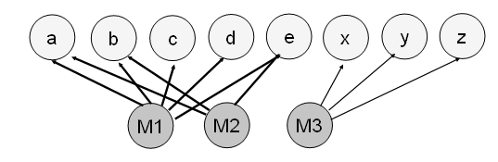
Lack of Cohesion of Methods: Example
Consider a class C with three methods M₁,M₂ and M₃. Let {I₁} = { a , b , c , d , e } and {I₂} = { a , b , e } and {I₃} = {x, y, z}. {I₁} ∩ {I₂} is nonempty, but {I₁} ∩ {I₃} and {I₂} ∩ {I₃} are null sets.
LCOM is the (number of null intersections - number of nonempty intersections), which in this case is 1.

Slide 15
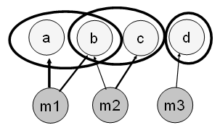
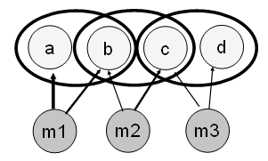
Lack of Cohesion of Methods:
More Examples
LCOM = max(2-1,0) = 1
LCOM = max(1-2,0) = 0

Slide 16
Measuring Quality
Source: Budgen, 1994, pp60-1
We have to turn our vague ideas about quality into measurables
examples...
The Quality Concepts
(abstract notions of
quality properties)
reliability
complexity
usability
mean time to failure?
information flow between modules?
time taken to learn how to use?
Measurable Quantities
(define some metrics)
run it and count crashes per hour???
count procedure calls???
minutes taken for some user task???
Counts taken from
Design Representations
(realization of the metrics)

